Slide 1
Introduction to Cloud Computing, Manufacturing Services Automated Construction Scheme (MSACS), and
Docker & Kubernetes
Prof. Min-Hsiung Hung
2018/12/20

Slide 2
Outline
Introduction to Cloud Computing
Cloud-based AVM System
MSACS (Manufacturing Services Automated Construction Scheme)
Introduction to Docker & Kubernetes (New-Generation Virtualization Technologies)

Slide 3
I. Introduction to Cloud Computing
References
[1] Mark Baker, An Introduction and Overview of Cloud Computing, ACET, University of Reading.
[2] Windows Azure Overview, Windows Azure Training Kit, Microsoft.

Slide 4
Cloud Computing
Cloud computing is an umbrella term used to refer to Internet based development and services.
A number of characteristics define cloud data, applications services and infrastructure:
Remotely hosted: Services or data are hosted on remote infrastructure.
Ubiquitous: Services or data are available from anywhere.
Commodified: The result is a utility computing model similar to traditional that of traditional utilities, like gas and electricity - you pay for what you would want!

Slide 5
Different Cloud Computing Layers‏
MS Live/ExchangeLabs, IBM,
Google Apps; Salesforce.com
Quicken Online, Zoho, Cisco
Application Service
(SaaS)‏
Google App Engine, Mosso,
Force.com, Engine Yard,
Facebook, Heroku, AWS, Microsoft Azure
Application Platform
3Tera, EC2, SliceHost,
GoGrid, RightScale, Linode
， Chunghwa Telecom
Server Platform
Storage Platform
Amazon S3, Dell, Apple, Dropbox...

Slide 6
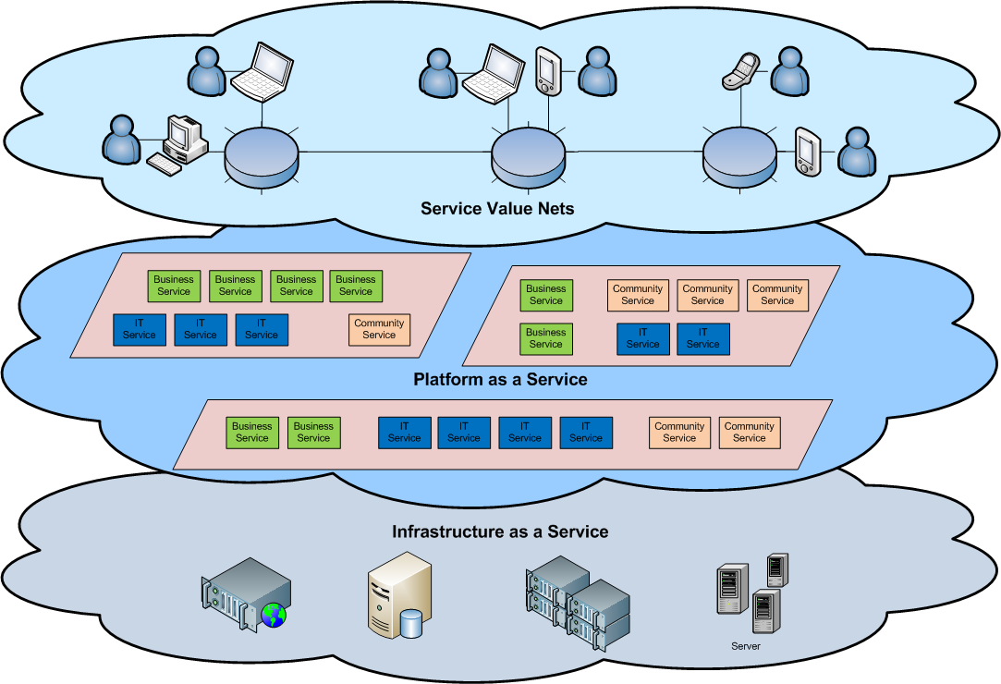
Cloud Architecture

Slide 7
Basic Cloud Characteristics
The “no-need-to-know” in terms of the underlying details of infrastructure, applications interface with the infrastructure via the APIs.
The “flexibility and elasticity” allows these systems to scale up and down at will – utilising the resources of all kinds (CPU, storage, server capacity, load balancing, and databases).
The “pay as much as used and needed” type of utility computing and the “always on!, anywhere and any place” type of network-based computing.

Slide 8
Basic Cloud Characteristics
Cloud are transparent to users and applications, they can be built in multiple ways - branded products, proprietary open source, hardware or software, or just off-the-shelf PCs.
In general, they are built on clusters of PC servers and off-the-shelf components plus Open Source software combined with in-house applications and/or system software.

Slide 9
Virtualization
Virtual workspaces:
An abstraction of an execution environment that can be made dynamically available to authorised clients by using well-defined protocols,
Resource quota (e.g. CPU, memory share),
Software configuration (e.g. O/S, provided services).
Implement on Virtual Machines (VMs):
Abstraction of a physical host machine,
Hypervisor intercepts and emulates instructions from VMs, and allows management of VMs,
VMWare, Xen, etc.
Provide infrastructure API:
Plug-ins to hardware/support structures
App
App
App
OS
OS
OS
Hypervisor
Hardware
Virtualized Stack

Slide 10
Virtual Machines
VM technology allows multiple virtual machines to run on a single physical machine.
App
App
App
App
App
Xen
Guest OS
(Linux)
Guest OS
(NetBSD)
Guest OS
(Windows)
VMWare
VM
VM
VM
Virtual Machine Monitor (VMM) / Hypervisor
UML
Denali
Hardware
etc.
Performance: Para-virtualization (e.g. Xen) is very close to raw physical performance!

Slide 11
Virtualization in General
Advantages of virtual machines:
Run operating systems where the physical hardware is unavailable,
Easier to create new machines, backup machines, etc.,
Software testing using “clean” installs of operating systems and software,
Emulate more machines than are physically available,
Timeshare lightly loaded systems on one host,
Debug problems (suspend and resume the problem machine),
Easy migration of virtual machines (shutdown needed or not).
Run legacy systems!

Slide 12
What is the purpose and benefits?
Cloud computing enables companies and applications, which are system infrastructure dependent, to be infrastructure-less.
By using the Cloud infrastructure on “pay as used and on demand”, all of us can save in capital and operational investment!
Clients can:
Put their data on the platform instead of on their own desktop PCs and/or on their own servers.
They can put their applications on the cloud and use the servers within the cloud to do processing and data manipulations etc.

Slide 13
Advantages of Cloud Computing
Lower computer costs
Improved performance
Reduced software costs
Instant software updates
Unlimited storage capacity
Increased data reliability
Easier group collaboration
Device independence

Slide 14
Disadvantages of Cloud Computing
Requires a constant Internet connection
Does not work well with low-speed connections
Stored data might not be secure
Stored data can be lost

Slide 15
Cloud Computing Patterns
On and Off
Inactivity
Period
On & off workloads (e.g. batch job)
Over provisioned capacity is wasted
Time to market can be cumbersome
Compute
t
Growing Fast
Successful services needs to grow/scale
Keeping up w/ growth is big IT challenge
Cannot provision hardware fast enough
Compute
t
Unpredictable Bursting
Unexpected/unplanned peak in demand
Sudden spike impacts performance
Can’t over provision for extreme cases
Compute
t
Predictable Bursting
Compute
Services with micro seasonality trends
Peaks due to periodic increased demand
IT complexity and wasted capacity
t

Slide 16



Cloud Computing
IaaS
PaaS
SaaS
Infrastructure-as-a-Service
Platform-as-a-Service
Software-as-a-Service
host
build
consume

Slide 17


Cloud Computing
Packaged Software
Infrastructure
(as a Service)
Platform
(as a Service)
Software
(as a Service)
Applications
Applications
You manage
Applications
Applications
Data
You manage
Data
Data
Data
Runtime
Runtime
Runtime
Runtime
Managed by vendor
You manage
Middleware
Middleware
Middleware
Middleware
Managed by vendor
O/S
O/S
O/S
O/S
Virtualization
Virtualization
Managed by vendor
Virtualization
Virtualization
Servers
Servers
Servers
Servers
Storage
Storage
Storage
Storage
Networking
Networking
Networking
Networking

Slide 18



Windows Azure
Comprehensive set of services that enable you to quickly build, deploy and manage applications across a global network of Microsoft-managed datacenters
Flexible
Open
Solid

Slide 19

Global Footprint

Slide 20
99.95% monthly SLA
Pay only for what you use

Slide 21
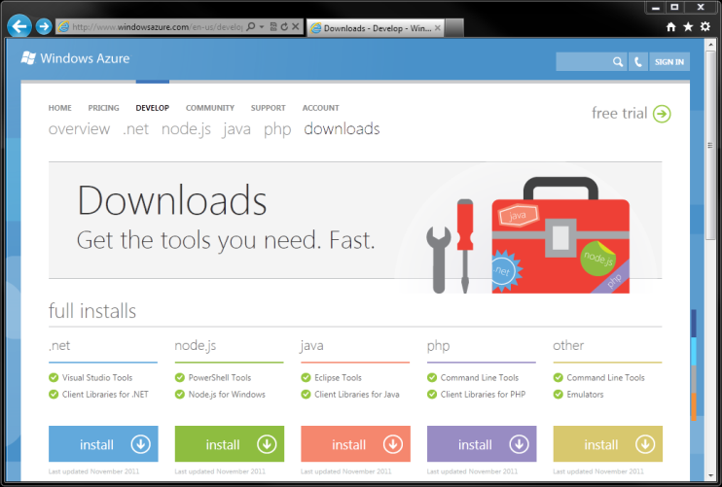
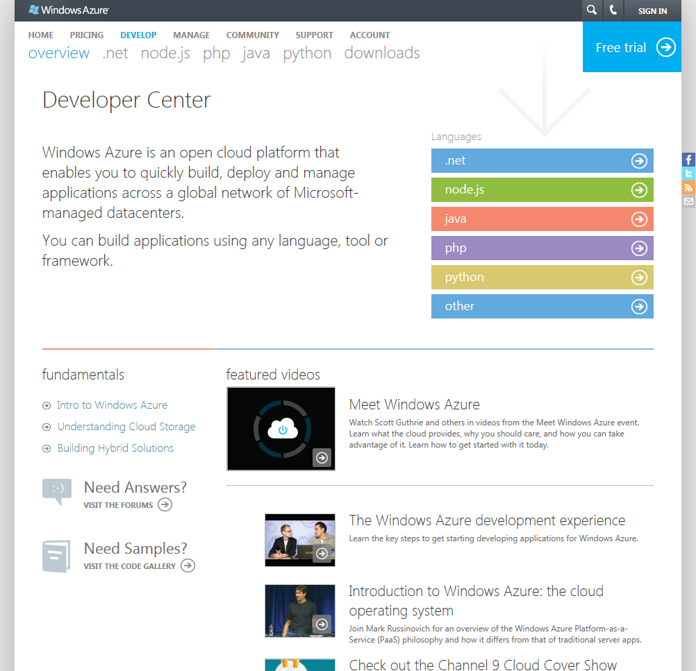
Multiple languages

Slide 22


Windows Azure Scenarios
Ideal for Applications Needing:
Scalability
Availability
Fault Tolerance
Common Application Uses:
Web Sites
Compute Intensive apps
Device Applications
Web APIs
Social Games

Slide 23
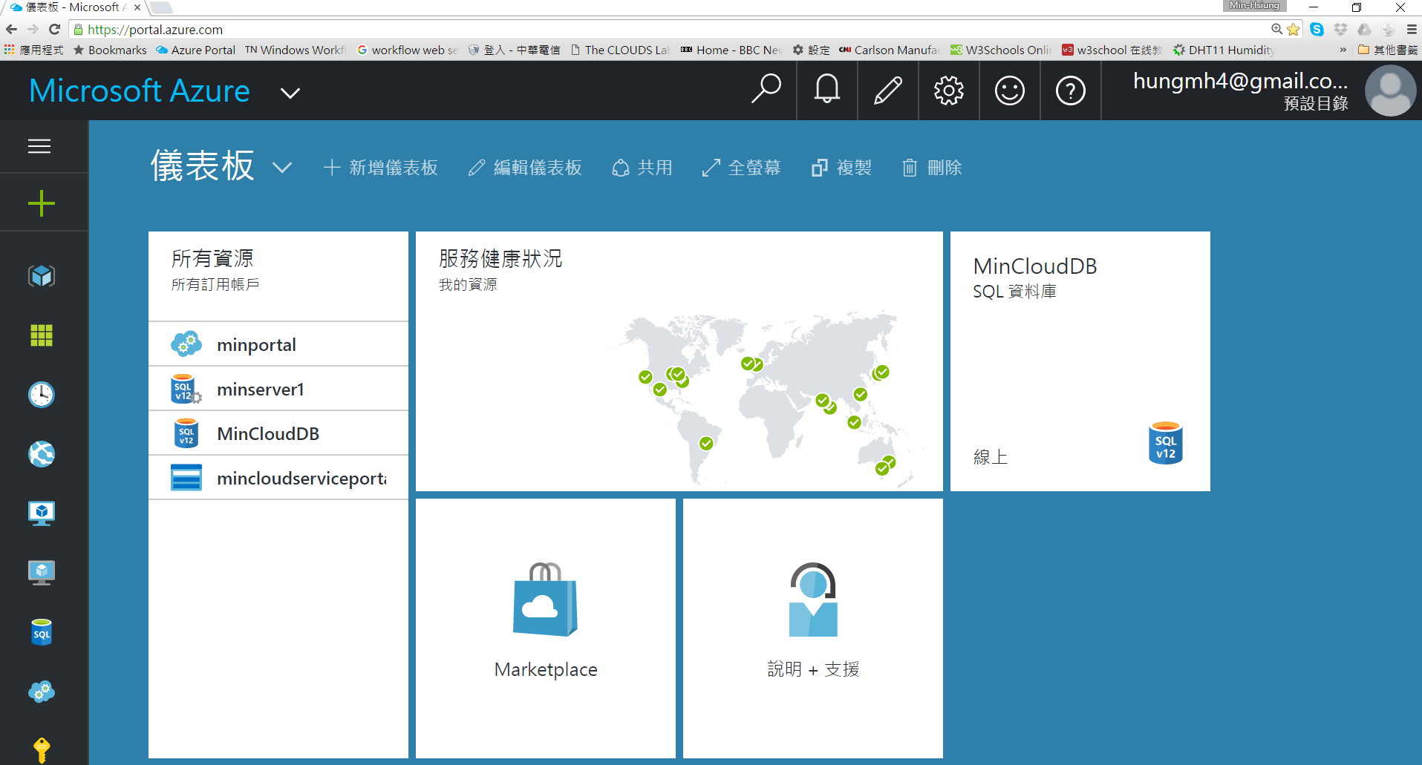
My Microsoft Azure Account Panel
Characteristics of Cloud: Resources Pool, Rapid Elasticity, Pay as You Use, On-demand Self-service, Ubiquitous Networking Access

Slide 24
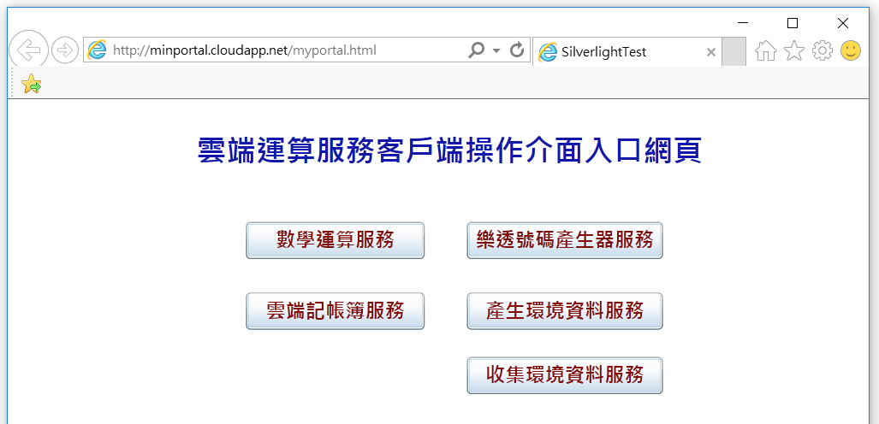
Cloud Services Demonstrated in my Cloud Computing Programming Course
Cloud Services deployed on Microsoft Azure Public Cloud

Slide 25
Cloud-based Equipment Monitoring System using Windows Azure
Windows Azure公有雲

Slide 26
Private Cloud Setup

Slide 27
II. Cloud-based AVM System
H.-C. Huang, Y.-C. Lin, M.-H. Hung*, C.-C. Tu, and F.-T. Cheng, “Development of Cloud-based Automatic Virtual Metrology System for Semiconductor Industry,” Robotics and Computer-Integrated Manufacturing, Vol. 34, pp. 30-43, Aug. 2015. [SCI]
M.-H. Hung*, Y.-Y. Li, Y.-C. Lin, C.-F. Wei, and F.-T. Cheng, “Development of a Novel Cloud-based Multi-tenant Model Creation Service for Automatic Virtual Metrology,” Robotics and Computer-Integrated Manufacturing, Vol. 44, pp. 174-189, April 2017. [SCI] DOI: 10.1016/j.rcim.2016.09.003

Slide 28
Contents
Background and Objectives
Architecture Design of Cloud-based AVM System
Design of Core Functional Mechanisms
Case Study and Testing Results
Conclusions and Future Work

Slide 29
Background and Objectives

Slide 30
Introduction to Virtual Metrology (VM)
VM (Virtual Metrology) is able to predict the production quality of workpieces, such as wafers or glasses, using process data of the production equipment.
VM can achieve real-time workpiece-to-workpiece quality monitoring.
VM has become a viable approach to conduct online monitoring of production equipment and processes in high-tech manufacturing industries, such as Semiconductor, TFT-LCD, and Solar-Cell industries .

Slide 31
Automatic Virtual Metrology (AVM) system
The AVM system has been developed to facilitate factory-wide VM deployment as shown as follows:

Slide 32
Some Limitations of the Existing AVM System
Existing AVM systems have several limitations in a factory-wide deployment with a great number of equipment:
Incurring high hardware cost, occupying a great volume of shop-floor space, and needing complex management efforts.
Deployment of VM servers needs to be conducted manually, which would be cumbersome and prone to error.
The AVM system cannot automatically increase or decrease the number of VM servers on demand, usually resulting in over-provisioning (having idle VM servers) or under-provisioning (having insufficient VM servers).

Slide 33
Limitations of the existing AVM System in Model Creation Functionality
No Support for Creating VM Models Simultaneously:
Cannot allow multiple users to create their respective VM models simultaneously because of only using a MC server to undertake the MC tasks
No Support for Cross-Factory Usage:
The existing AVM system was designed to be deployed in a factory so that it is confined to be used locally in a factory in terms of creating VM models
Lacking Robust Scheme for Processing MC Requests:
Lack failover and load-balancing mechanisms for processing a large quantity of incoming MC requests.

Slide 34
Objectives of this Work
Propose an approach of building cloud-based AVM systems, which could
effectively remedy the above-mentioned shortcomings of existing AVM systems in plant-wide deployment and in model creation functionality
keep the reworking efforts as little as possible to transform a AVM system into a cloud-based one.

Slide 35
Architecture Design of Cloud-based AVM System

Slide 36
Architecture of the cloud-based AVM system
Create a private cloud environment VMware vSphere and its associated software, are used to create a private cloud environment.
Virtualizing all servers Leaving the original implementation codes of each server unchanged.
Design an Virtual Machine Administrator (VMA) Host and perform the major designed functional mechanisms.
Automatic-Deployment
Automatic-Scaling
Automatic-Serving

Slide 37
Framework Design of Virtual Machine Administrator
VMA Control Kernel Communicating with the MES and the VM manager, as well as handing messages and commands among functional components and performing functional mechanisms.
Communication Interface
MES Command：
Receive commands form MES.
Virtual Metrology Command： Send commands to the VM manager to perform actions on the target VM server.
Cloud Instance Management Managing the virtual machines in the private cloud environment by using VMware vSphere API.
VM Server Configuration Automatically setting the configuration of the VM server.
Best Model Selection It is responsible for selecting the best-fit model from the Central DB.
XML-based Command Parser It is responsible for parsing the XML-based commands sent by the MES.
Notes:
強調這些是為了針需求建去設計

Slide 38
Operational flow of the cloud-based AVM system
A6
A4
A8
A5
A1
A7
A3
A2
A1

Slide 39
Design of Core Functional Mechanisms
Design of Automatic-Scaling Mechanism
Design of Automatic-Deployment Mechanism
Design of Automatic-Serving Mechanism

Slide 40
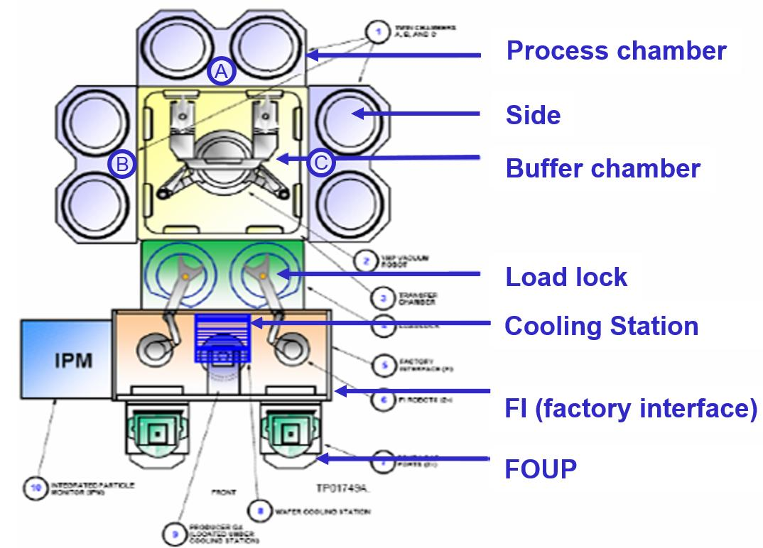
Terminologies (1/2)
Combination Information of Equipment
A01, Chamber A, Side 1
A01, Chamber A, Side 2
A01, Chamber B, Side 1
A01, Chamber B, Side 2
Architecture of the ULKCVD Equipment A01
Notes:
名詞定義
Combination 是虛擬量測的組合，以晶圓廠(半導體)為例
這個機台是ULKCVD
它上面共有3個chamber，不過其中一個是用來buffer
實際生產只有 A和 B chamber
而每個chambe上都有兩個side
分別為side1 和side2
所以這台ULKCVD同一時間會產生4個wafer 分別由.A1 A2 B1 B2產生

Slide 41



Terminologies (2/2)
Template Virtual Machine
A virtual machine installed with the VM server software, but lacking the combination information of equipment, prediction model, and IP.
Spare Virtual Machine
When a cloned virtual machine is turned on and assigned with an IP, it is called a spare virtual machine, which is ready to be configured to become a virtual VM server.。
VM Server
When the spare virtual machine is equipped with prediction models and the combination information of equipment, it becomes a VM server.
Template
Virtual Machine
[Clone]
Spare
Virtual Machine
[prediction model+
combination information+
IP]
VM Server

Slide 42
Schema Design of VMA Database
CombinationDEF Table: Define the combination information.
Case | UMC | UMC | UMC | FATEK | FATEK
FieldName | Field1 | Field2 | Field3 | Field1 | Field2
Def | DEP_EQPID | DEP_CHAMBER | DEP_SIDE | STAGE | STEP
VMList Table: Store the statuses of virtual machines.
IP | 192.168.0.15 | 192.168.0.16 | 192.168.0.17 | 192.168.0.18
VMName | UMC-VMS-15 | UMC-VMS-16 | FATEK-VMS-17 | ScaleOutVM
VMStatus | On | Off | On | On
LastestUsageTime | 2013-08-12 17:21:47 | 2013-08-12 17:21:50 | 2014-02-12 14:15:32
IPUsed | true | true | true | true
CombinationStatus | true | true | true | False
Field 1 | A01 | A01 | OP1
Field 2 | A | A | 2
Field 3 | 1 | 2
Case | UMC | UMC | FATEK
active VM server
VM server
turned off
spare virtual machine

Slide 43
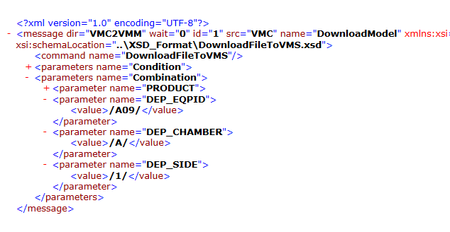
Design of MES Command
By parsing and extracting the information from the DEP_EQPID, DEP_CHAMBER, and DEP_SID elements, the VMA server is able to determine the combination for setting the VM server to serve the requested VM task.
A
B

Slide 44
Design of
Automatic-Scaling Mechanism (1/3)
Scale out a VM server: to turn on a VM server
Notes:
開機一台上面有VMServer的虛擬機 (已經設定好combination等)

Slide 45
Design of Automatic-Scaling Mechanism(2/3)
25
Scale Out a Spare Virtual Machine: to generate a new spare virtual machine
Notes:
開機一台備用的虛擬機(還未設定好combination)

Slide 46
Design of Automatic-Scaling Mechanism(3/3)
Scale in a VM server: to turn off a VM server (periodically triggered by a timer)
Notes:
關機一台虛擬機

Slide 47
Design of Automatic-Deployment Mechanism(1/3)
This mechanism is to automatically transform a spare virtual machine into an active VM server:
Notes:
如何把spare 虛擬機設定成VMserver

Slide 48
Design of Automatic-Deployment Mechanism(2/3)
Notes:
如何把spare 虛擬機設定成VMserver

Slide 49
Design of Automatic-Deployment Mechanism(3/3)
Notes:
如何把spare 虛擬機設定成VMserver

Slide 50
Design of Automatic-Serving Mechanism
30
This mechanism is to automatically have a VM server to serve a requested VM task:
Notes:
這張是總圖

Slide 51
Case Study and Testing Results

Slide 52
Testing environment of PC-Server-version AVM system (1/2)

Slide 53
Testing environment of PC-Server-version AVM system (2/2)
Physical Server Specifications:
Test Data Information:
Computer | PC 1 | PC 2
Software | VM Manager | VM Server
OS | Windows 7 | Windows 7
CPU | Intel® Core™ i5-3450 | Intel® Core™ i5-3450
Clock Speed | 3.1 GHz | 3.1 GHz
RAM | 4 GB | 4 GB
DEP- EQPID | DEP- Chamber | DEP- Side | Time Period | Operation VM Server | Number of workpiece
A01 | A | 1 | 2012/10/15 09:30 ~ 2012/10/15 10:17 | VM Server 01 | 10
A01 | A | 2 | 2012/10/15 09:00 ~ 2012/10/15 10:16 |  | 10
A01 | B | 1 | 2012/10/15 16:30 ~ 2012/10/15 16:40 |  | 10
A01 | B | 2 | 2012/10/15 09:00 ~ 2012/10/15 11:50 |  | 10
A02 | A | 1 | 2012/10/15 13:00 ~ 2012/10/15 16:20 |  | 10
A02 | A | 2 | 2012/10/15 09:00 ~ 2012/10/15 13:18 |  | 10
A02 | B | 1 | 2012/10/15 14:00 ~ 2012/10/15 17:20 |  | 10
A02 | B | 2 | 2012/10/15 09:00 ~ 2012/10/15 13:20 |  | 10
 |  |  |  |  | Total 80
Notes:
強調是80筆

Slide 54
Testing environment of the cloud-based AVM system (1/2)
Notes:
f

Slide 55
Testing environment of the cloud-based AVM system (2/2)
Virtual Machine Specifications
Test Data Information
Computer | Virtual Machine
OS | Windows 7
CPU | Intel® Xeon® E5-2625
Clock Speed | 2.0 GHz
RAM | 4 GB
Test Data Information
DEP- EQPID | DEP- Chamber | DEP- Side | Time Period | Operation VM Server | Number of workpiece
A01 | A | 1 | 2012/10/15 09:30 ~ 2012/10/15 10:17 | VM Server 01 | 10
A01 | A | 2 | 2012/10/15 09:00 ~ 2012/10/15 10:16 | VM Server 02 | 10
A01 | B | 1 | 2012/10/15 16:30 ~ 2012/10/15 16:40 | VM Server 03 | 10
A01 | B | 2 | 2012/10/15 09:00 ~ 2012/10/15 11:50 | VM Server 04 | 10
A02 | A | 1 | 2012/10/15 13:00 ~ 2012/10/15 16:20 | VM Server 05 | 10
A02 | A | 2 | 2012/10/15 09:00 ~ 2012/10/15 13:18 | VM Server 06 | 10
A02 | B | 1 | 2012/10/15 14:00 ~ 2012/10/15 17:20 | VM Server 07 | 10
A02 | B | 2 | 2012/10/15 09:00 ~ 2012/10/15 13:20 | VM Server 08 | 10
 |  |  |  |  | Total 80
Notes:
強調是80筆

Slide 56
Comparison of the execution time of predicting the production quality of 80 wafers
Notes:
實體是雲端的5~6倍

Slide 57
Comparison of Prediction Accuracy
VM results of the PC-Server-based AVM system:
VM results of the cloud-based AVM system:
NN | MAPE (%) | Standard Deviation
Phase I | 0.3954 | 15.0091
Phase II | 0.2894 | 14.6837
NN | MAPE (%) | Standard Deviation
Phase I | 0.3954 | 15.0091
Phase II | 0.2894 | 14.6837
Notes:
強調是80筆

Slide 58
Comparison of the time to deploy 8 VM servers (automatic deployment mechanism vs. manual deployment)

Slide 59
Conclusions and Future Work
59
This paper proposes an approach of building cloud-based AVM systems, including an architecture design and several functional mechanisms, which enables one to only take small efforts to migrate an AVM system to the cloud.
The cloud-based AVM system can complete the total VM tasks about five times as fast as the PC-Server-version counterpart, while achieving the same prediction accuracy.
The proposed cloud-based AVM system could automatically complete many tasks with good performance, including the automatic scaling, automatic deployment, and automatic serving of VM servers.
The future work includes developing a model creation service supporting multiuser based on private cloud.

Slide 60
III. 雲製造服務自動建置機制
MSACS
(Manufacturing Services Automated Construction Scheme)
榮獲2018 IEEE機器人與自動化國際研討會(ICRA 2018) 最佳自動化論文決賽入圍。(2018/5)
刊登於IEEE Robotics and Automation Letter (RA-L)國際期刊： (2018/7)
C.-C. Chen, M.-H. Hung*, P.-Y. Li, Y.-C. Lin, Y-Y. Liu, and F.-T. Cheng, “A Novel Automated Construction Scheme for Efficiently Developing Cloud Manufacturing Services,” IEEE Robotics and Automation Letters (RA-L), Vol. 3, No. 3, pp. 1378-1385, July 2018.

Slide 61
智慧製造 (Intelligent Manufacturing)
工業4.0的智慧工廠願景：
工業4.0的核心願景是建立智慧工廠，藉由先進的ICT技術，包含物聯網、雲端計算、網路實體系統、巨量資料分析與人工智慧，實現靈活、高效率、高品質、降低成本的製造流程。
需要一個支援智慧製造的平台：
如何建立一個智慧製造平台以促進實現智慧工廠，對於工業4.0時代的製造業來說是必要的。
智慧製造平台-AMCoT：
在主題中，將介紹本研究團隊所開發的智慧製造平台- AMCoT(先進製造物聯雲)。
Notes:
Yesterday, one speaker mentioned an alphabetical soup:
SM=IoT+CPS+AI (ML)

Slide 62
雲製造 (Cloud Manufacturing)
雲製造的定義:
將製造資源封裝和虛擬化為可透過網路依需求使用的雲端服務。
雲製造是一種新的、服務導向的製造模式 雲製造具有徹底改變製造業的潛力。目前已有許多雲製造相關的應用被提出。
在本主題中，將介紹本研究團隊所開發之「雲製造服務自動建置系統- MSACS 」 。

Slide 63
智慧製造平台
先進製造物聯雲AMCoT
榮獲2018 IEEE自動化科學與工程國際研討會(CASE 2107) 最佳應用論文獎。(2017/8)
刊登於IEEE Robotics and Automation Letter (RA-L)國際期刊： (2017/7)
Y.-C. Lin, M.-H. Hung*, H.-C. Huang, C.-C. Chen, H.-C Yang, Y.-S. Hsieh, and F.-T. Cheng, “Development of Advanced Manufacturing Cloud of Things (AMCoT) - A Smart Manufacturing Platform,” IEEE Robotics and Automation Letters (RA-L), Vol. 2, No. 3, pp. 1809-1816, July 2017.

Slide 64
雲製造範例: 智慧製造平台-AMCoT
雲端包含了數個智慧雲製造服務
IPM: Intelligent Predictive Maintenance
AVM: 自動虛擬量測Automatic Virtual Metrology
IYM: Intelligent Yield Management
工廠端包含各種物聯網邊緣裝置，如虛實整合代理人CPA
Notes:
This page shows a cloud manufacturing example.
(1) We developed a smart manufacturing platform, called AMCoT.
(2) In this figure, we apply AMCoT to a semiconductor bumping process.
(3) On the cloud side, we develop various intelligent cloud manufacturing services to support manufacturing activities, including AVM (Automatic Virtual Metrology) service, IPM (Intelligent Predictive Maintenance) service, and IYM (Intelligent Yield Management) service.
45s

Slide 65
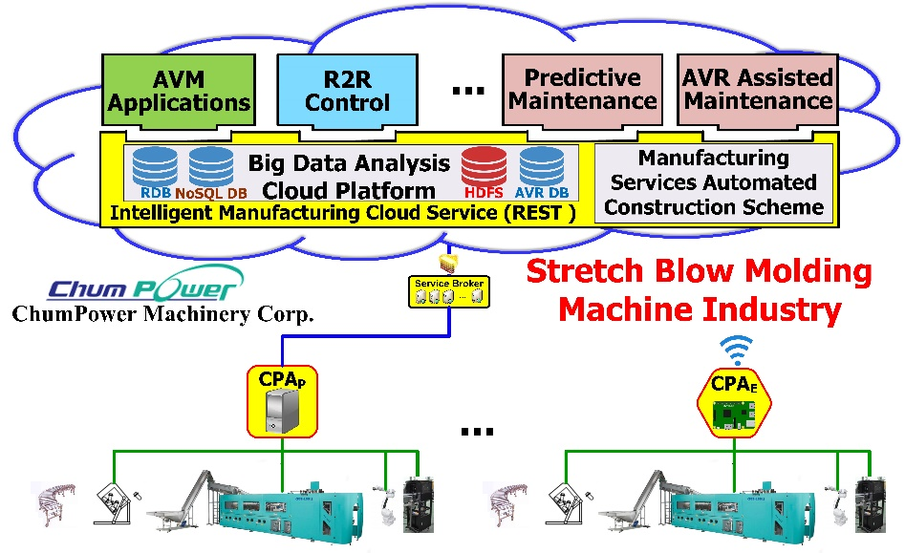
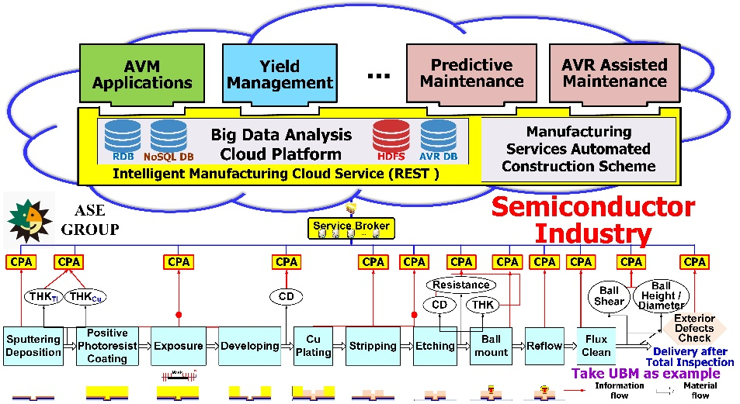
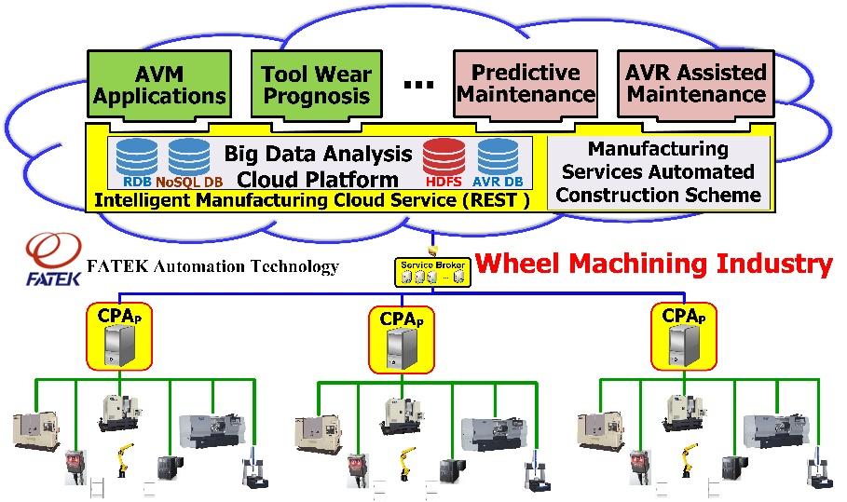
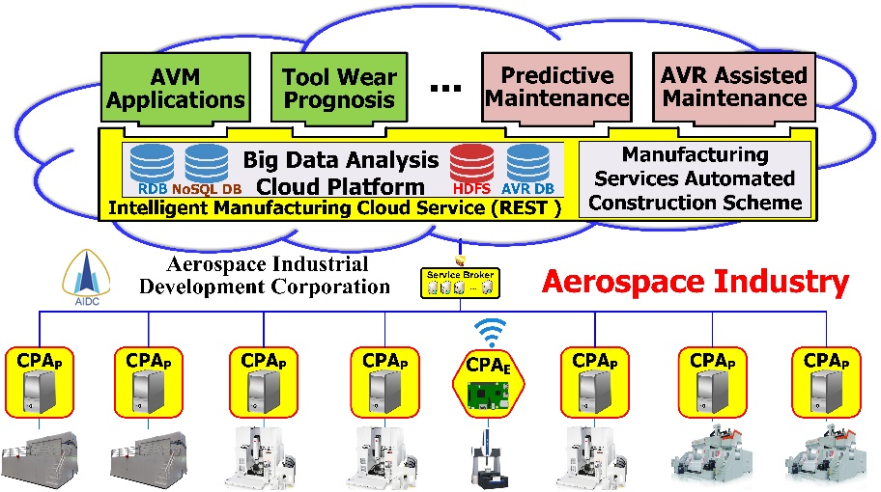
AMCoT產業應用案例
AMCoT已經成功應用於數個不同的製造產業
AMCoT可以為不同產業提供不同的雲製造服務
AMCoT之成果已被科技部選為自動化學門之先進製造亮點計畫
MSACS
MSACS
MSACS
MSACS
Notes:
(1) AMCoT has been successfully applied to several manufacturing industries, including Semiconductor Industry, Wheel Machining Industry, Aerospace Industry, and Stretch Blow Molding Machine Industry.
(2) AMCoT needs to provide different cloud manufacturing services for them
(3) For example, in addition to AVM, IPM, and IYM services, we need to provide Tool Wear Prognosis service to Wheel Machining Industry and Run-to-Run Control service to Stretch Blow Molding Machine Industry.
(4) Previously, we manually developed these cloud manufacturing services. However, manually transforming local software into cloud services involves a lot of programming efforts and is complicated, error-prone, and time-consuming. This motivates this study. We develop an automated way MSACS to automatically construct these services.
40s

Slide 66
建構雲製造服務的挑戰
如何自動且有效的建置雲製造服務是促進雲製造服務中一個必要且具有挑戰性的問題。
服務計算領域提出了大量解決服務組合問題的方法，其主要概念是將多個現有Web服務集成到工作流中以創建新的增值服務。
然而，這些服務組合相關的研究建立於假設服務已經存在的前提上，並沒有解決如何自動建置服務的問題
使用單機軟體包手動建置雲製造服務必須經過許多步驟，複雜而耗時。

Slide 67
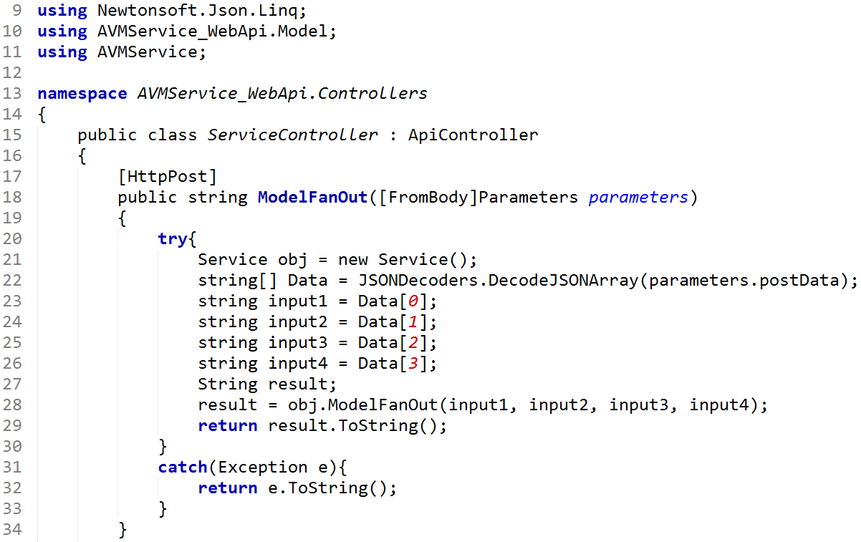
手動開發雲製造服務步驟
開發人員打開集成開發環境(IDE):
手動管理
單機軟體包
撰寫
程式碼
Web服務包
將Web服務
部署至雲端
建立Web應用專案
設定Web API的URL
IDE
編譯與建置專案
WSP
雲製造
服務
服務專案產生階段
服務建置階段
服務部署階段
Web API範例程式碼
如果想要構建n個Web API，開發人員需要重複n次這樣的程式碼，這容易出錯且耗時。
Notes:
This page illustrates the process of manually developing a cloud manufacturing service:
(1) Developer uses IDE to develop a Web Service Project (WSP) by doing programming, and then builds the WSP to generate a Web Service Package, which is then deployed to the cloud to become a cloud manufacturing service.
(2) The most tedious part is to manually manage the software libraries, develop source codes and set URIs of Web APIs.
(3) Here shows an example code of a Web API. If wanting to build to n Web APIs, the developer needs to repeat n times of such coding, which is tedious and time-consuming.
46s

Slide 68
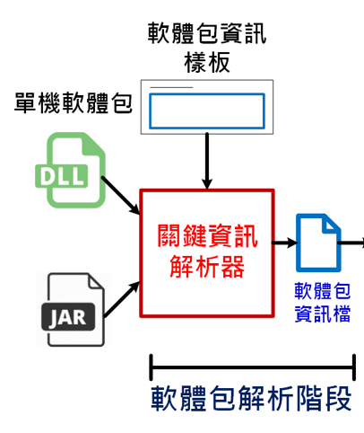
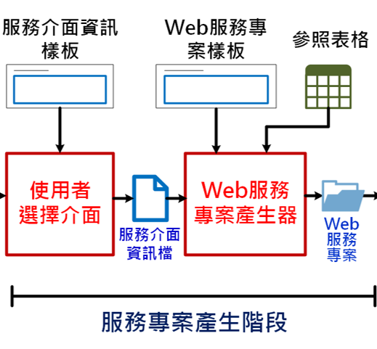
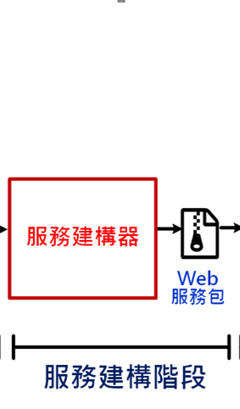
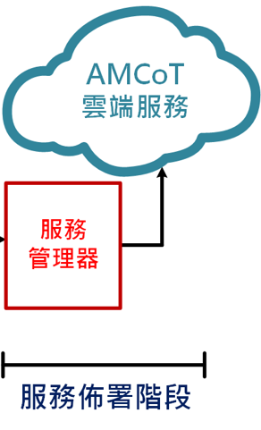
MSACS流程設計
手動建置雲製造服務流程
建立Web
應用專案
手動管理
單機軟體包
撰寫程式碼
設定URI
路由
編譯與建置
專案
Web
服務包
部署雲製造服務
IDE
MSACS自動服務建置流程
Notes:
This page shows the workflow design of MSACS. For comparison, the manual workflow using IDE is shown on the top, and the automated workflow of MSACS is shown on the bottom.
In Phase 1, for managing lib packages, we design KI Extractor to automatically extract Key Information of Library and store extracted Key Information into a Lib-Info JSON file.
In Phase 2, Web GUI is designed to display the Key Information of the library and allows users to select methods that they want to build as Web APIs. Then, the key information of selected Web APIs is stored into a SI-Info JSON file. Also, WSP Generator is designed to automatically generate a Web Service Project (WSP) after reading the SI-Info File.
In Phase 3, Service Constructor is designed to automatically build the WSP to generate a Web Service Package.
In Phase 4, Service Manager is designed to deploy the Web Service Package to the cloud to become a cloud manufacturing service.
45s

Slide 69
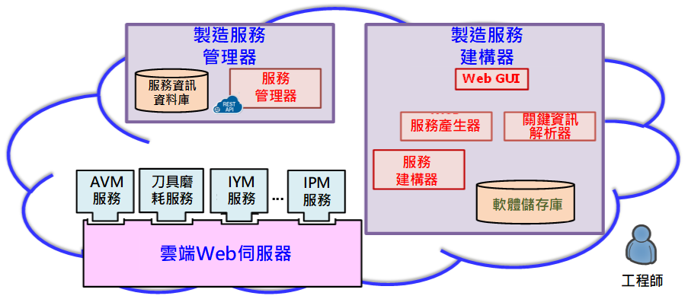
MSACS架構設計
MSACS是一個雲端系統，可分為三個部分
(2)
(1)
(3)
Notes:
MSACS is a cloud-based system whose architecture consists of three parts.
The first part is Manufacturing Service Constructor consisting of Web GUI, KI Extractor, WSP Generator, Service Constructor, and Software Repository, for constructing services.
The second part is Service Manager for deploying services.
The third part is Cloud Web Server for hosting services.

Slide 70
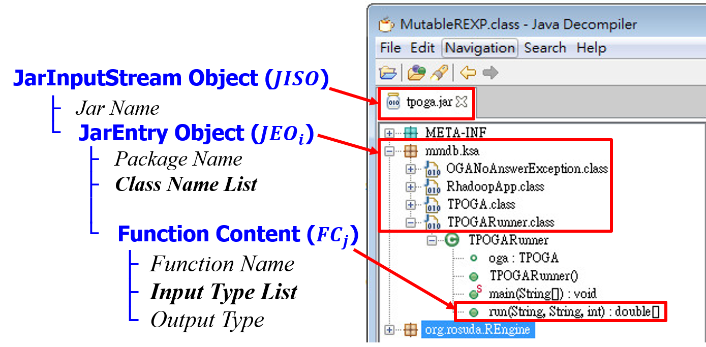
Hierarchical information of a Jar SSLP in a Java decompiler

Slide 71
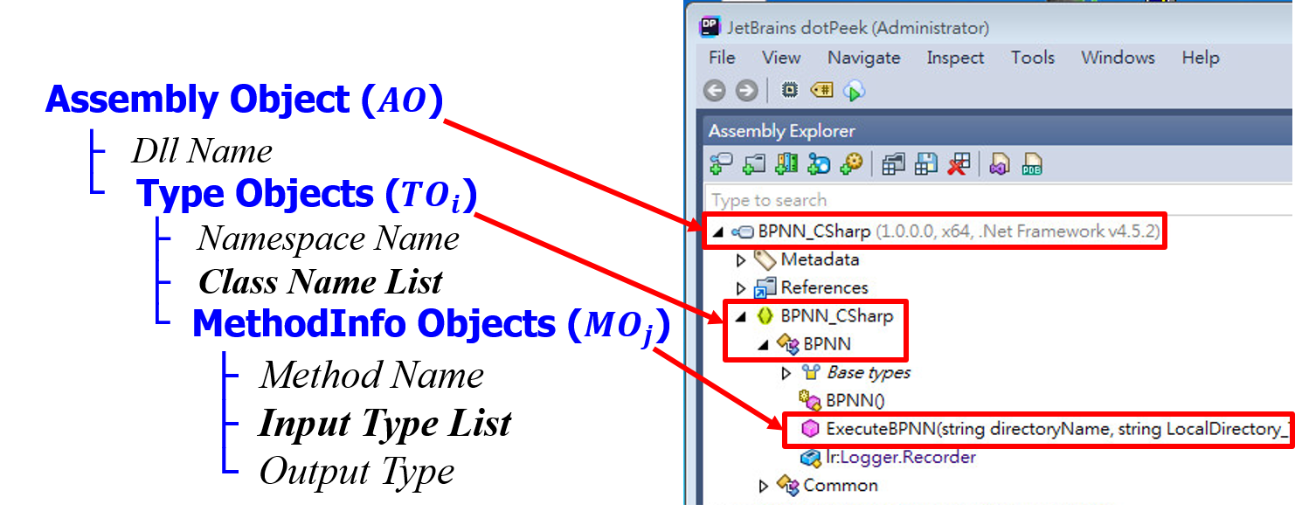
Hierarchical information of a C# DLL SSLP in a C# decompiler

Slide 72
The generic KI extraction algorithm of SSLPs

Slide 73
Illustration of the Lib. Info. Template in JSON

Slide 74
Illustration of the SI Info. Template in JSON

Slide 75
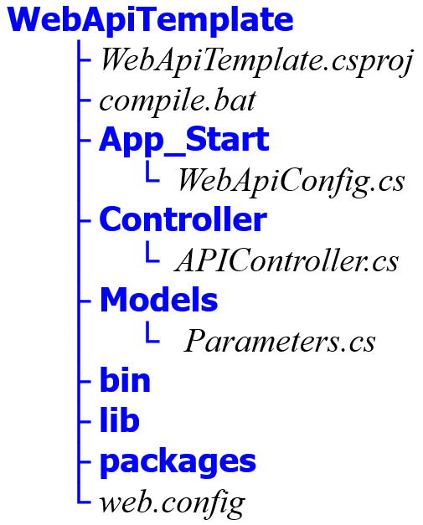
C# Web Service Project (WSP) Template

Slide 76
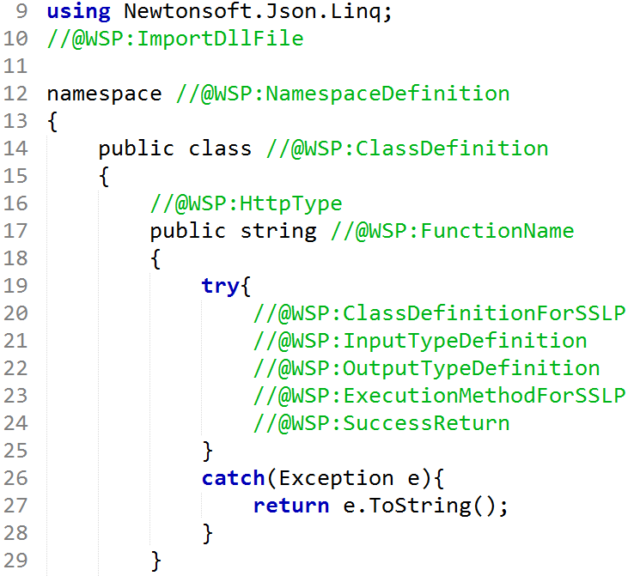
Example of “APIController.cs” for C# WSP Template

Slide 77
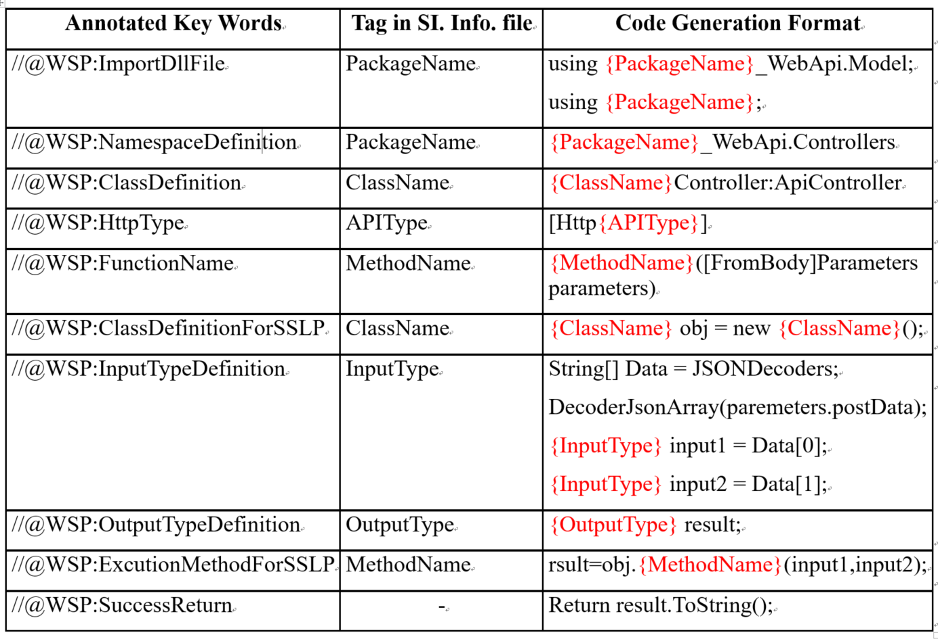
Annotated Keywords-SI Tags Lookup Table

Slide 78
Flowchart of the automated source code generation

Slide 79
The automated service construction mechanism designed in Server Constructor

Slide 80
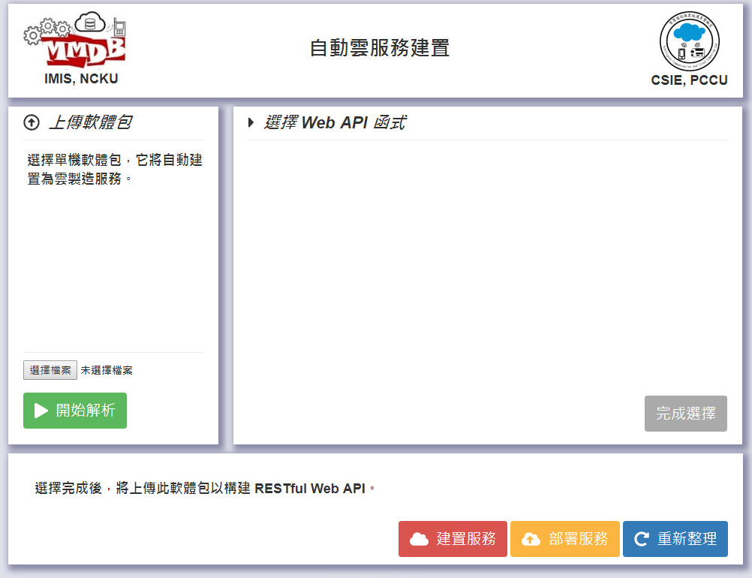
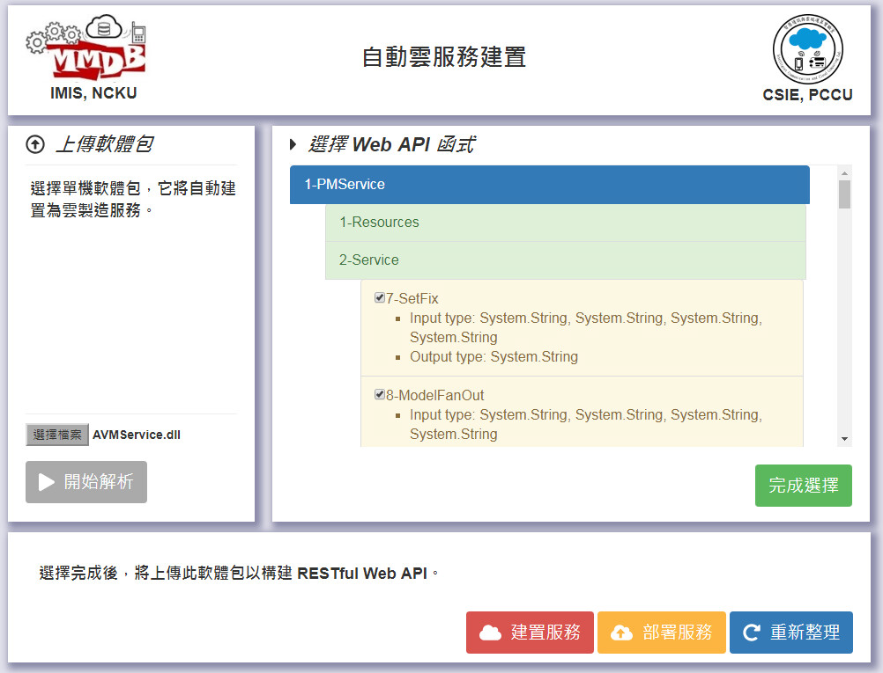
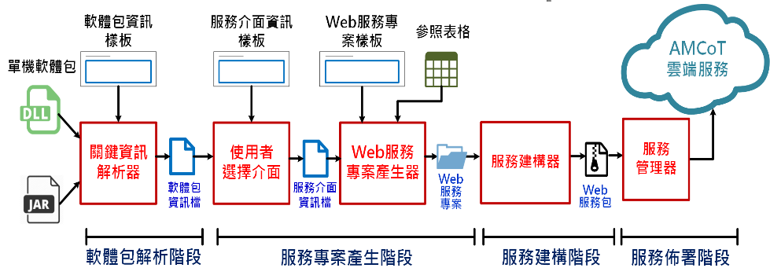
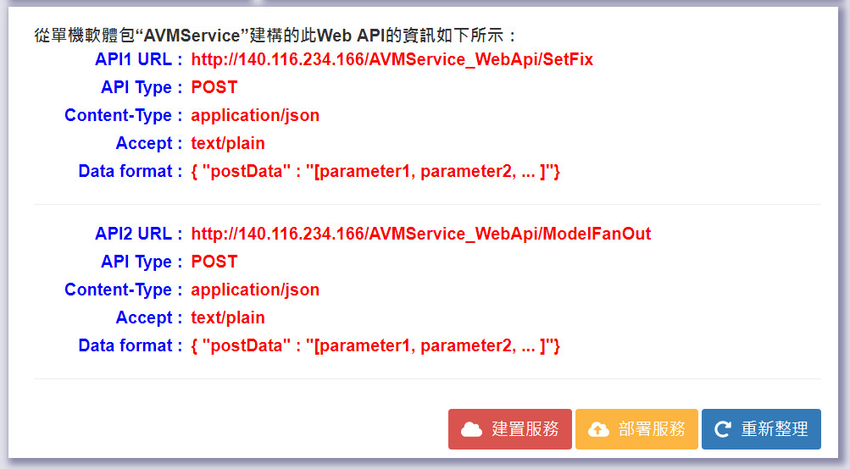
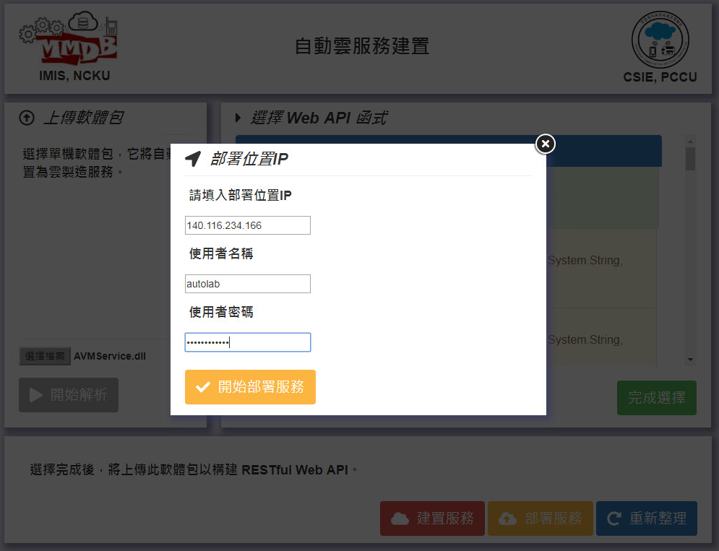
MSACS
軟體包
資訊檔
服務介面資訊檔
Web
服務專案
Web
服務包
雲製造
服務
Notes:
This page illustrates the operations of MSACS with GUIs.
First, the developer uploads the library and clicks the [Start Parsing] button to generate Lib-Info File.
Then, the library’s all methods are displayed on the GUI.
Next, the developer selects methods that he wants to build as Web APIs and then clicks the [Selection Done] button to generate SI-Info File.
After that, the developer clicks the [Construct Service] button to construct a web service package.
Finally, the developer clicks the [Deploy Service] button and types in the IP address of the target Cloud Web Server to complete the construction of the CMfg service.
40s

Slide 81
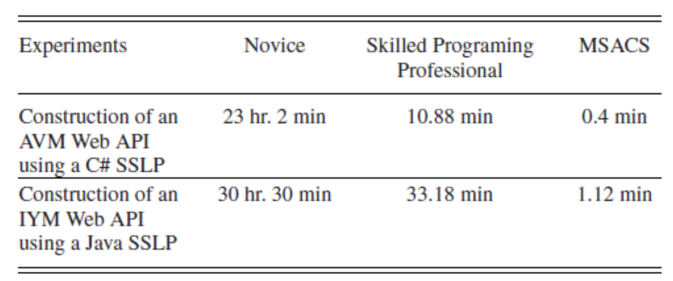
Comparisons of development times of Novice, Skilled Professional, and ACSCMS

Slide 82
應用展示範例
利用MSACS為輪圈加工產業自動建構AVM服務

Slide 83
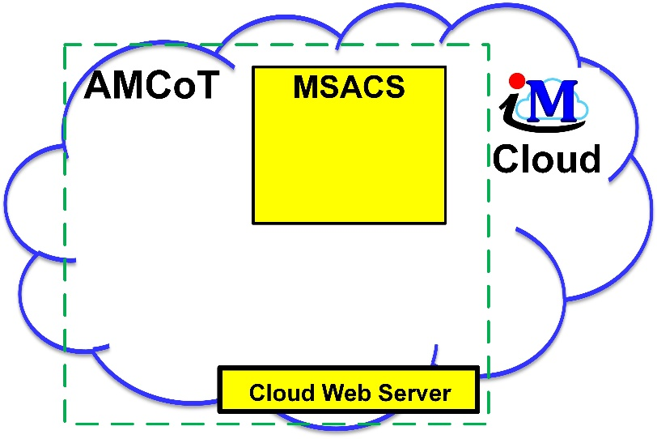
展示案例: 使用MSACS為AMCoT建構AVM服務 並在輪圈加工中進行在線全面檢測
A.3
A.2
AVM Service Package
AVM Service Package
A.4
B.3
B.2
B.1 CPA 將製程資料送至AMCoT上所建構的AVM服務.
B.2 AVM 服務計算虛擬量測結果
B.3 將虛擬量測結果顯示於Web GUI
A.1
B.1
A.1使用者操作Web GUI上傳單機軟體包
A.2Web GUI將單機軟體包送至MSACS進行解析
A.3 MSACS建置AVM 服務包
A.4 MSACS部署AVM服務至AMCoT上的雲端服務器

Slide 84
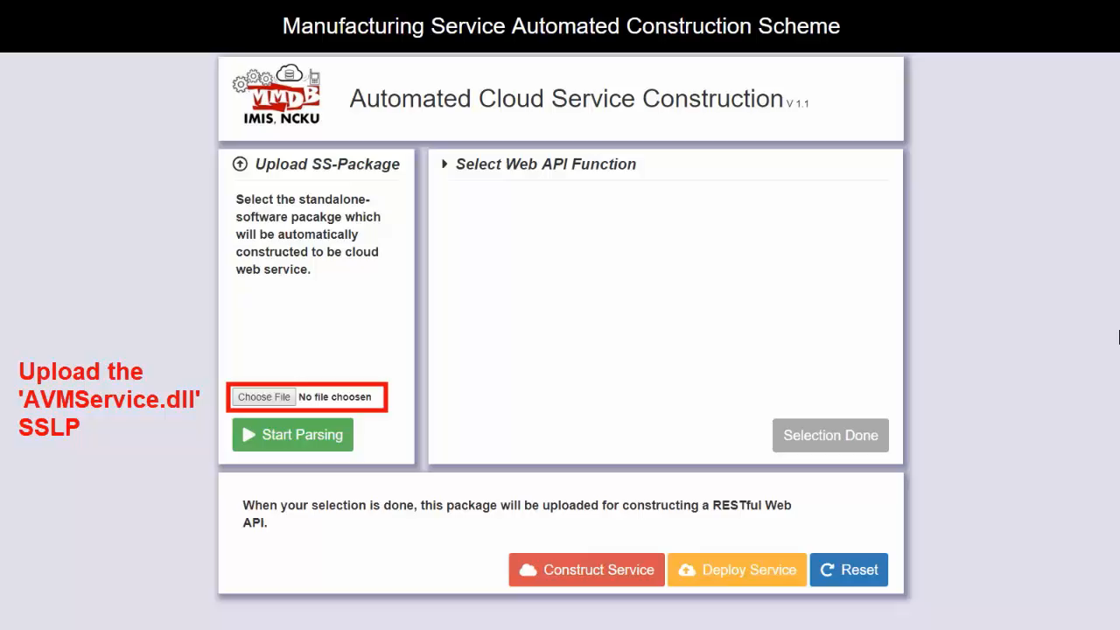
案例影片展示:
使用MSACS為AMCoT建構AVM服務並在輪圈加工中進行在線全面檢測

Slide 85
IV. Introduction to Docker & Kubernetes (New-Generation Virtualization Technologies)Architecture)

Slide 86
容器虛擬化技術簡介 (Container Virtualization Technology)
Docker的來源與願景標語：
Docker [1] 始於誕生於2013年的一個開源專案，其目標是實作輕量級的作業系統虛擬化解決方案，由於其輕量化的虛擬層級以及易於移植的特性(Docker的賣點：Build, Ship, and Run Any App, Anywhere)，有利於雲端系統的開發，目前已成為當紅的新一代虛擬化技術。
下頁圖為在一台伺服器上不同的虛擬化架構示意比較圖[2]，說明如下：
圖1(a)為傳統虛擬機(Virtual Machine, VM)技術架構，先在伺服器硬體上安裝Hypervisor (如VMware、Hyper-V等)，然後在Hypervisor建立許多虛擬機(VMs)，每台VM封裝了作業統(Guest OS)、軟體執行環境、相依套件(Bins/Libs)及在VM內執行的應用程式；VM之間彼此完全隔離，透過Hypervisor共享硬體資源，因此，VM在概念上屬於硬體層級之虛擬化技術。圖1(b)為Docker 容器(Container)虛擬化技術架構，先在伺服器上安裝作業系統，然後在作業系統上安裝Docker軟體以具備Docker Engine而成為容器主機(Container Host)，之後即可在容器主機上建立許多容器(Containers)，每一個Container封裝了軟體執行環境、相依套件(Bins/Libs)以及在容器內執行的應用程式；Container之間彼此完全隔離，共作業系統核心及容器主機的資源，因此，Container在概念上屬於作業系統層級之虛擬化技術。圖1(c)為結合VM與Container之混合式虛擬化架構，換言之，Docker Containers可建置在實體機上，如圖1(b)，也可建置在虛擬機內。

Slide 87
一台伺服器上不同的虛擬化技術架構
(a)傳統虛擬機(VM)-硬體層級虛擬化，(b)輕量虛擬化技術(Container)-作業系統層級虛擬化，(c)結合VM與Container-混合式虛擬化架構。

Slide 88
Docker虛擬化技術包括三個基本概念(1/2)
Docker虛擬化技術包括三個基本概念[1]：
映像檔(Image)、容器(Container)及倉庫(Repository)。
映像檔(Image)：
Docker 映像檔就是一個唯讀的模板，例如：一個映像檔可以包含一個完整的 ubuntu 作業系統環境，裡面僅安裝了Apache 及使用者需要的應用程式。Docker採用AUFS (Advanced Union File System)一層(Layer)疊一層的方式由下而上將內含的軟體打包建置成唯讀的映像檔。Docker 提供了一個很簡單的機制來建立映像檔或更新現有的映像檔，使用者甚至可以直接從其他人那裡下載一個已經做好的映像檔來直接使用。
容器(Container)：
映像檔可以用來建立容器，容器在啟動的時候會建立一層可讀、寫的最上層(稱為Container Layer)，然後採用Copy-and-Write方式運作，因此，之後對容器所做的操作與改變，都儲存在這最上層，不會變更到Image的內容。Docker 利用容器來執行應用程式，容器是從映像檔建立的執行實例，它可以被啟動、開始、停止、刪除。每個容器都是相互隔離的、保證安全的平台。可以把容器看成是一個簡易版的作業系統環境（包括root使用者權限、程式空間、使用者空間和網路空間等）和在其中執行的應用程式。

Slide 89
Docker虛擬化技術包括三個基本概念(2/2)
倉庫(Repository)：
倉庫是集中存放映像檔檔案的場所。實際上，倉庫註冊伺服器(Registry)上往往存放著多個倉庫，每個倉庫中又包含了多個映像檔，每個映像檔有不同的標籤（tag）。倉庫分為公開倉庫（Public）和私有倉庫（Private）兩種形式。最大的公開倉庫是 Docker Hub，存放了數量龐大的映像檔供使用者下載。使用者也可以在本地網路內建立一個私有倉庫。當使用者建立了自己的映像檔之後就可以使用 push 命令將它上傳到公有或者私有倉庫，這樣下次在另外一台機器上使用這個映像檔時候，只需要從倉庫上pull 下來就可以了。

Slide 90
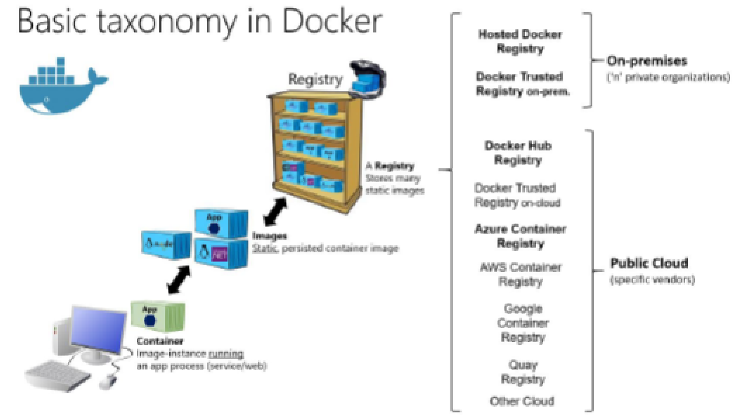
Taxonomy of Docker Terms and Concepts
Source: C.Torre, B. Wagner, and M. Rousos, “.NET Microservices: Architecture for Containerizaed Applications,” e-book, Microsoft Corporation, 2017

Slide 91
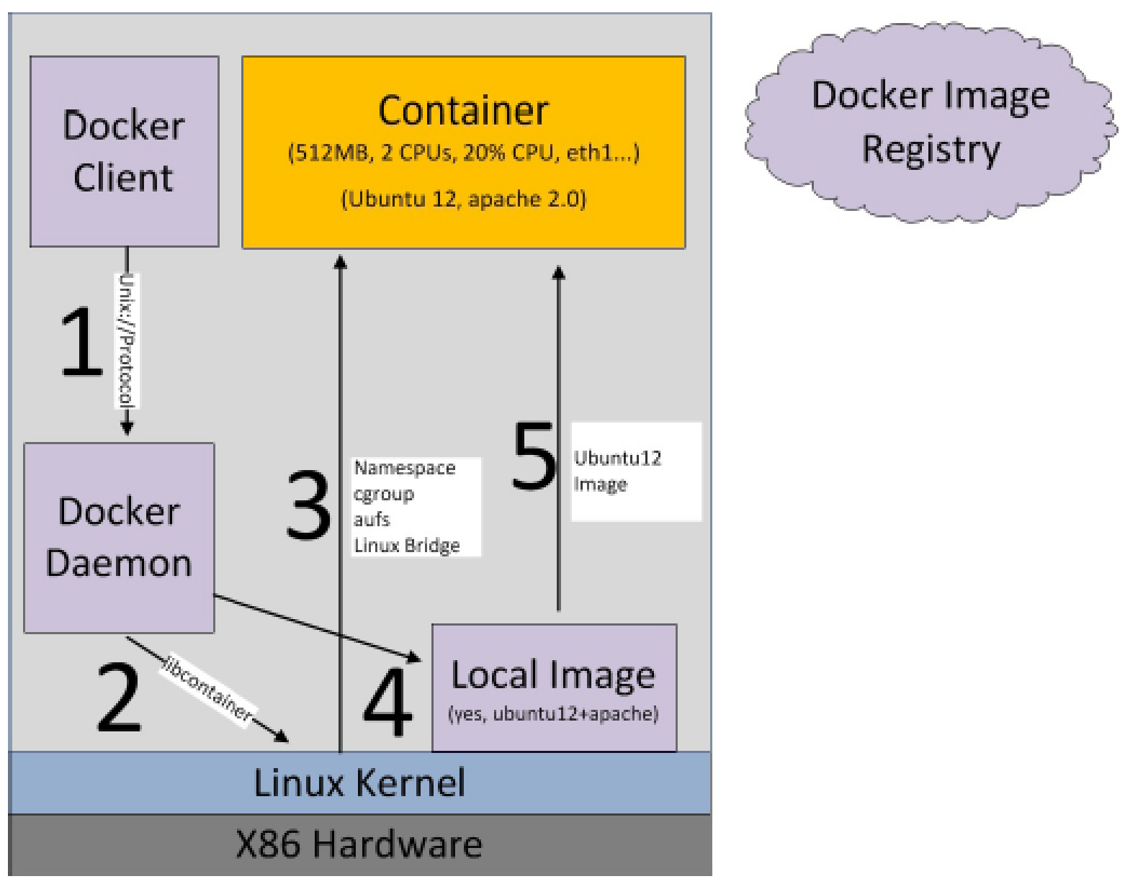
Docker執行過程示意圖-利用本機端的映像檔建立Container
Source:最完整的Docker聖經-Docker原理圖解及全環境安裝，joshhu，GitBook。

Slide 92
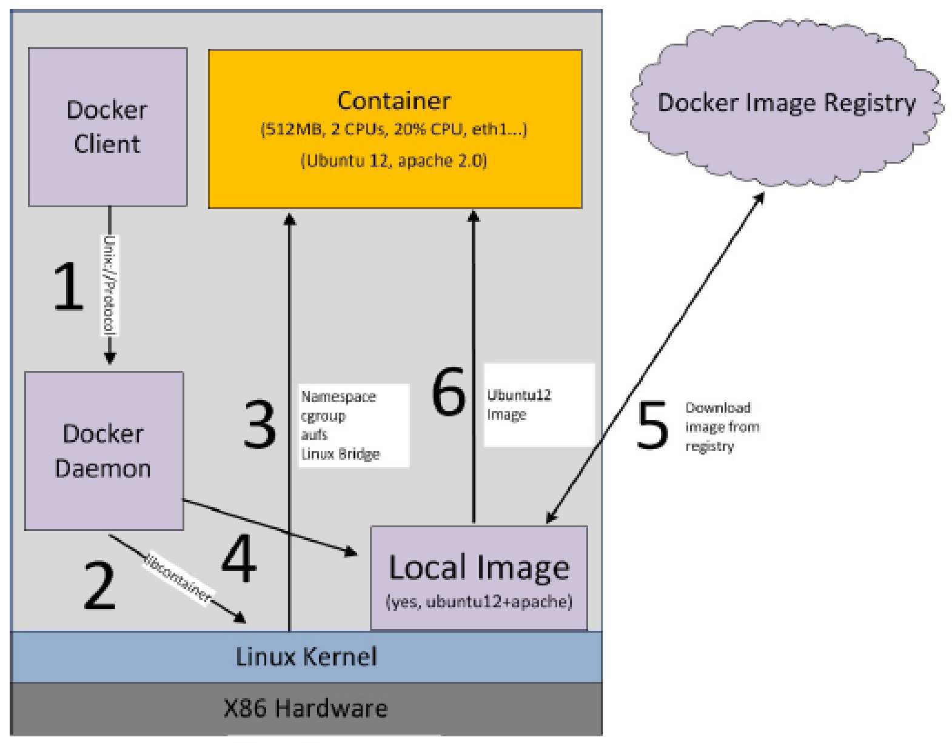
Docker執行過程示意圖-利用倉庫中的映像檔建立Container
Source:最完整的Docker聖經-Docker原理圖解及全環境安裝，joshhu，GitBook。

Slide 93
Docker Container跟傳統虛擬化技術VM相比之優勢(1/3)
更快(秒即)的開機時間：
VM的開機時間需要數分鐘，而Container的啟動時間只要幾秒。
占用硬碟空間更小(MB為單位)：
VM佔用的硬碟空間以GB為單位，而Container以MB為單位。
一台主機可同時執行高達超過千個容器：
單一主機可同時運行的VM數最多數十個，而單一主機最高可同時運行數千個Container，而且彼此完全隔離。
不消耗額外的系統資源，程式執行效能接近原生(Native)程式：
Docker Container的執行不需要額外的虛擬化支援，它是核心層級的虛擬化，因此可以實現更有效率的虛擬化。Container容器除了執行其中應用外，基本不消耗額外的系統資源，使得Container內應用程式的效能很高，接近原生。

Slide 94
Docker Container跟傳統虛擬化技術VM相比之優勢(2/3)
更快速的軟體交付和部署：
傳統上在軟體開發結束後，所產出的成果即是應用程式的程式碼或執行檔。為了讓這些應用程式可以順利執行，開發團隊也得準備完整的部署文件，讓維運團隊得以部署應用程式。不過，即便如此，仍然常常發生部署失敗的狀況。
而Docker透過將運作應用程式所需要的系統環境，相依的套件與程式庫以及應用程式本身打包成映像檔(Image)，然後透過映像檔來建立一套開發容器。在開發完成之後，維運人員可以直接使用這個容器來部署應用程式，達到應用程式跨平台間的無縫接軌運作。
由於Docker Container很輕很快，且Container的啟動時間為秒級，可以大量地節約開發、測試與部署的時間，達到開發和維運（DevOps）人員最希望的境界：一次建立或設定，就可以在任意地方正常執行。

Slide 95
Docker Container跟傳統虛擬化技術VM相比之優勢(3/3)
更輕鬆的遷移和擴展：
Docker Container幾乎可以在任意的平台上執行，包括實體機器、虛擬機、雲端環境(公有雲、私有雲) [4]、個人電腦、伺服器、微小電腦(如Raspberry Pi與Odroid) [5]等，目前Windows也可以執行Docker Container [2]，Docker Container這種兼容性可以讓使用者把一個應用程式從一個平台直接遷移到另外一個。
適合用來實現微服務架構：
Container很適合用來發展微服務的運算資源管理與實現微服務架構。

Slide 96
Docker Container跟傳統虛擬化技術VM相比之優勢(3/3)
更輕鬆的遷移和擴展：
Docker Container幾乎可以在任意的平台上執行，包括實體機器、虛擬機、雲端環境(公有雲、私有雲) [4]、個人電腦、伺服器、微小電腦(如Raspberry Pi與Odroid) [5]等，目前Windows也可以執行Docker Container [2]，Docker Container這種兼容性可以讓使用者把一個應用程式從一個平台直接遷移到另外一個。
適合用來實現微服務架構：
Container很適合用來發展微服務的運算資源管理與實現微服務架構。

Slide 97
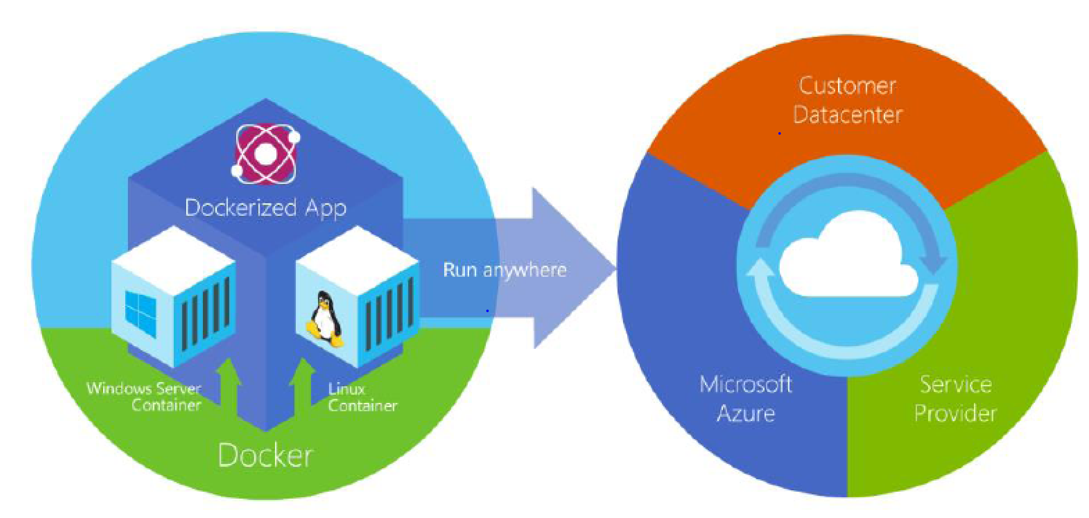
Docker deploys containers at all layers of the hybrid cloud
Source: C.Torre, B. Wagner, and M. Rousos, “.NET Microservices: Architecture for Containerizaed Applications,” e-book, Microsoft Corporation, 2017

Slide 98
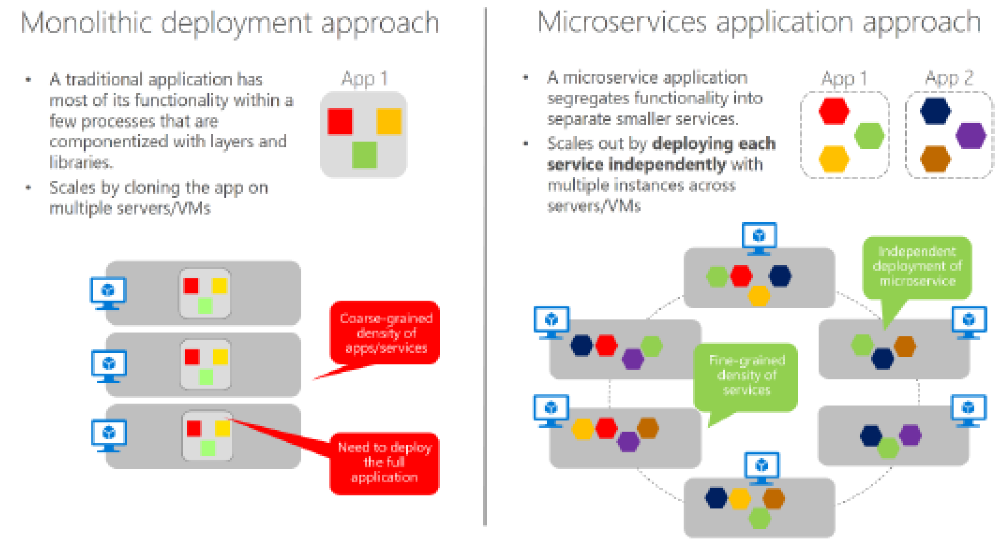
Monolithic Deployment versus Microservices Approach
Source: C.Torre, B. Wagner, and M. Rousos, “.NET Microservices: Architecture for Containerizaed Applications,” e-book, Microsoft Corporation, 2017

Slide 99
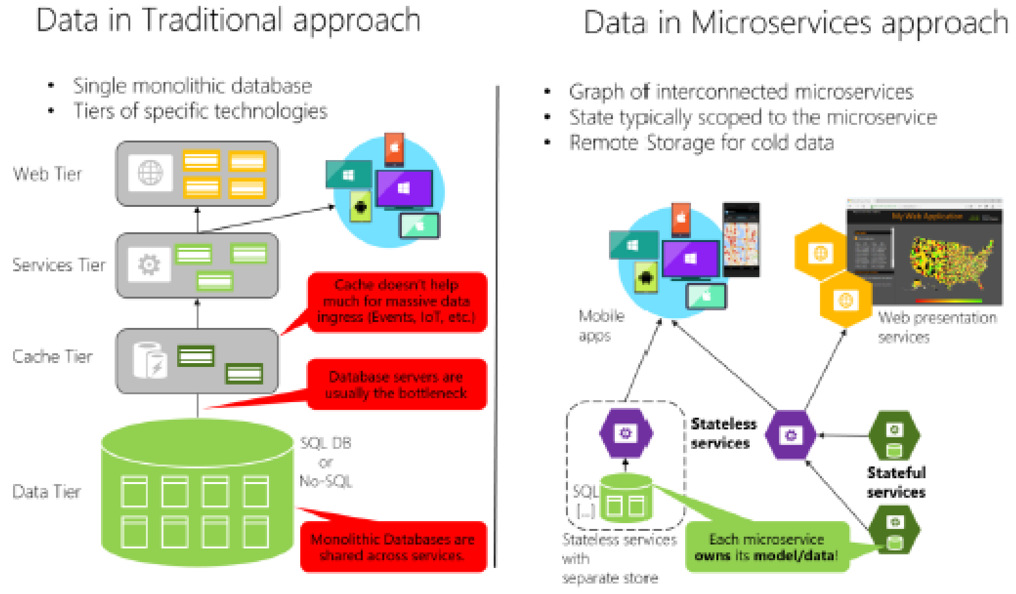
Data Sovereignty Comparison: Monolithic Database versus Microservices
Source: C.Torre, B. Wagner, and M. Rousos, “.NET Microservices: Architecture for Containerizaed Applications,” e-book, Microsoft Corporation, 2017

Slide 100
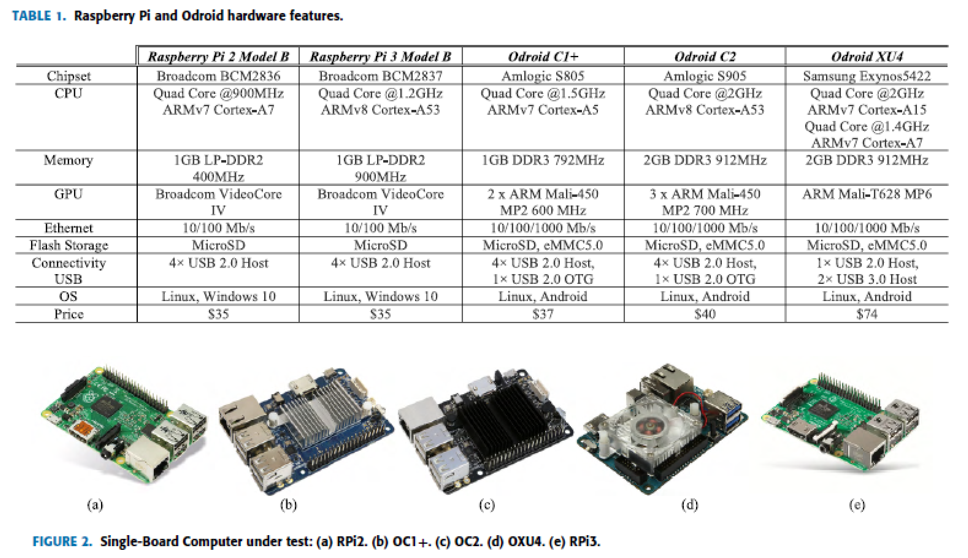
Single-Board Computer under test: (a) RPi2. (b) OC1C. (c) OC2. (d) OXU4. (e) RPi3 and their respective specification
Source: R. Morabito, “Virtualization on Internet of Things Edge Devices with Container Technologies: A Performance Evaluation,” IEEE Access, Vol. 5, pp. 8835-8850, June 2017.

Slide 101
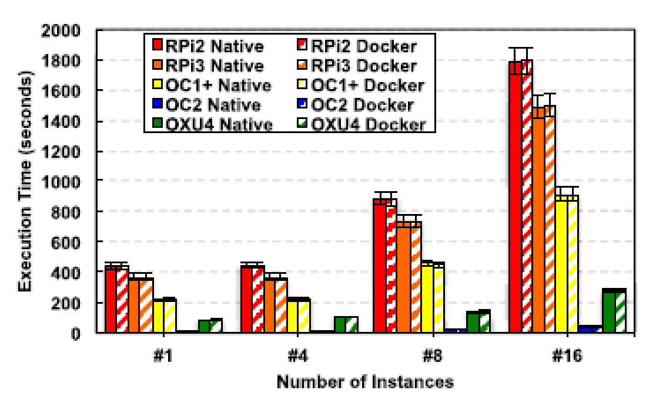
Comparison of CPU Stress Test Performance
Source: R. Morabito, “Virtualization on Internet of Things Edge Devices with Container Technologies: A Performance Evaluation,” IEEE Access, Vol. 5, pp. 8835-8850, June 2017.

Slide 102
Docker與其生態系統現況與未來趨勢(1/2)
Docker Container虛擬化技術的種種優勢，可有效解決軟體開發與維運所需的持續遞送與部署(Continuous Delivery and Deployment)的難題。適合用來實現微服務架構：
目前大型雲端平台與技術供應商(包括Google、Microsoft、Amazon、VMware等)在其公有雲平台與虛擬化軟體均支援Docker Container的運作[6]。
Docker 的生態系統(Ecosystem)目前有大公司在後面支持，例如Google目前推出開源之Kubernetes [6][7][8]，可用來建立Container的叢集(Cluster)及管理與維運容器化的應用程式，Docker也推出類似的產品Swarm [1]。

Slide 103
Docker與其生態系統現況與未來趨勢(2/2)
Google擬在未來將其當前提供的雲端服務全部容器化。Docker的社區和生態圈(Community)已經出現像Java和Linux那樣的發展態勢。
工業界也開始了開放容器倡議OCI (Open Container Initiative) [9]，致力於容器格式與其執行環境的標準化。
預期，Docker與開源的Kubernetes將會是未來雲端運算的關鍵技術，一個企業或軟體研發團隊若能投入研究與應用這些關鍵新技術，將可以搶占技術先機，並可以快速地產生經濟利益。

Slide 104
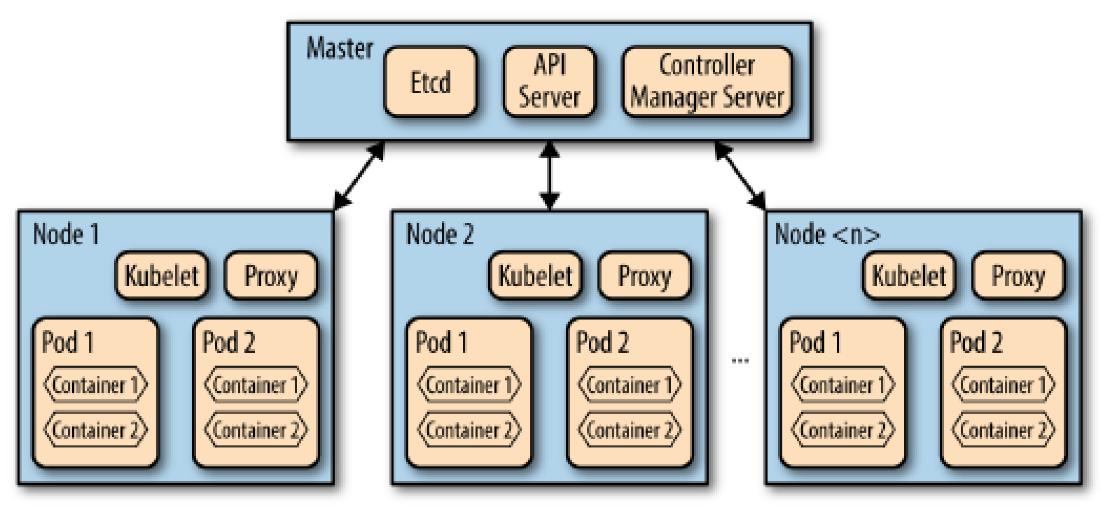
The Expanded Kubernetes Layout
Source: David K. Rensin, Kubernetes-Scheduling the Future at Cloud Scale,O'REILLY, 2015.

Slide 105
References of Docker and Kubernetes
[1] Docker Web Site. URL: https://www.docker.com/
[2] C.Torre, B. Wagner, and M. Rousos, “.NET Microservices: Architecture for Containerizaed Applications,” e-book, Microsoft Corporation, 2017.
[3] Docker-從入門到實踐，2014年9月。URL: https://github.com/philipz/docker_practice
[4] O. Adam, Y.C. Lee, and A.Y. Zomaya, “Stochastic Resource Provisioning for Containerized Multi-Tier Web Services in Clouds,” IEEE Transactions on Parallel and Distributed Systems, Vol. 28, No. 7, pp. 2060-2073, July 2017.
[5] R. Morabito, “Virtualization on Internet of Things Edge Devices with Container Technologies: A Performance Evaluation,” IEEE Access, Vol. 5, pp. 8835-8850, June 2017.
[6] D. Bernstein, “Containers and Cloud: From LXC to Docker to Kubernetes,” IEEE Cloud Computing, pp. 81-84, Sept. 2014.
[7] A. Khan, “Key Characteristics of a Container Orchestration Platform to Enable a Modern Application,” IEEE Cloud Computing, pp42-48, Sept./Oct. 2017.
[8] P. Chekin, “Multi-container pods and container communication in Kubernetes,” Open Cloud Digest, August 2017. URL: https://www.mirantis.com/blog/multi-container-pods-and-container-communication-in-kubernetes/
[9] Open Container Initiative. URL: https://www.opencontainers.org/

